Slide 1
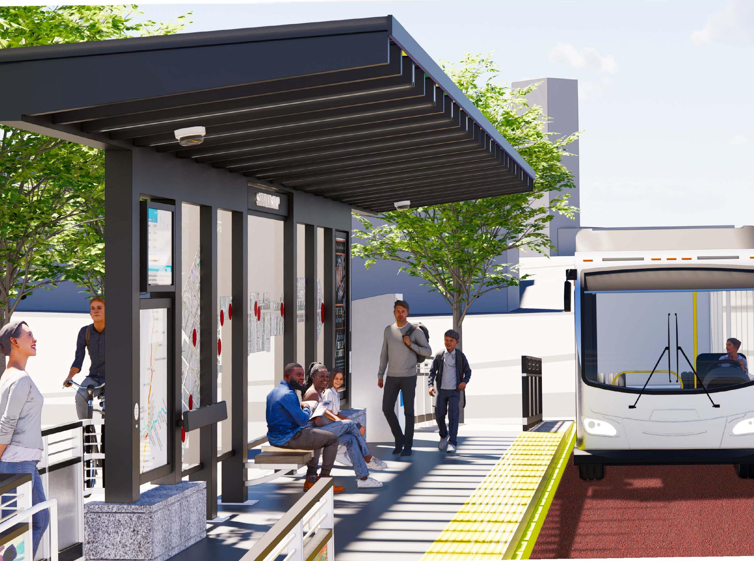
City of Atlanta
2023 Q2 Update
June 14, 2023
Collie Greenwood
General Manager/CEO

Slide 2
Agenda
Project Updates
Additional Good News
More MARTA Atlanta Program and FY24 Budget

Slide 3
Agenda
More MARTA Atlanta Program & FY24 Budget

Slide 4
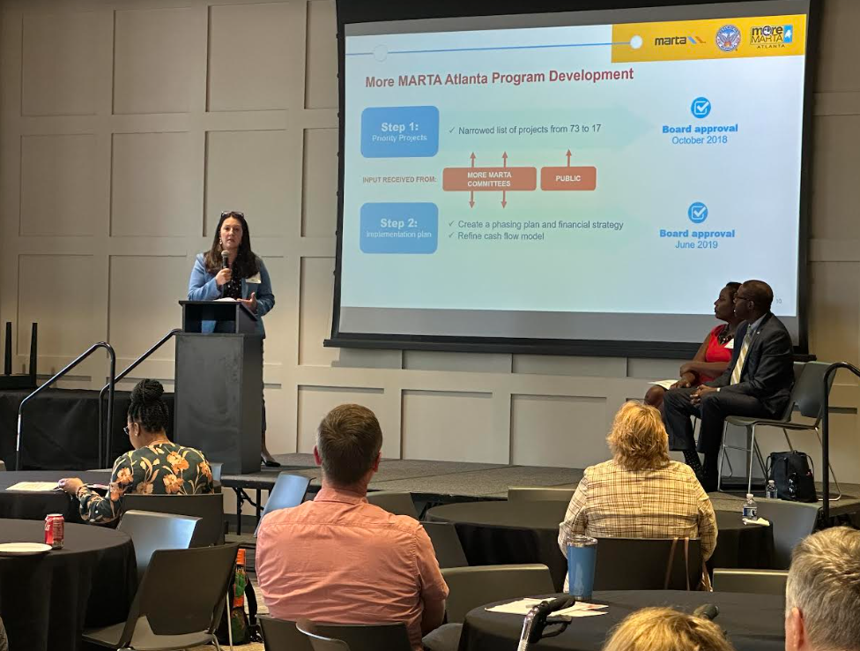
MORE MARTA ATLANTA RESEQUENCING –
PUBLIC MEETING SUMMARY
In-Person Tuesday, April 18, 2023, 6-8 p.m.
Sylvan Hills Middle School 1461 Sylvan Rd SW, Atlanta GA 30310 Total attendance: 45
Virtual: Wednesday, April 19, 2023, 6-8 p.m.
Zoom https://youtu.be/OlnXkFj5aeo Total attendance: 155
In-Person: Thursday, April 20, 2023, 6-8 p.m.
All Saints Episcopal Church 634 W Peachtree St NW, Atlanta GA 30308 https://youtu.be/uHig24sqNE8 Total attendance: 55
Themes
  Concern regarding the Streetcar East Extension, with opponents expressing a strong preference for preserving access to neighborhoods and businesses
  Concern about operational challenges faced by existing Streetcar
  Concern about construction impacts generally

Slide 5
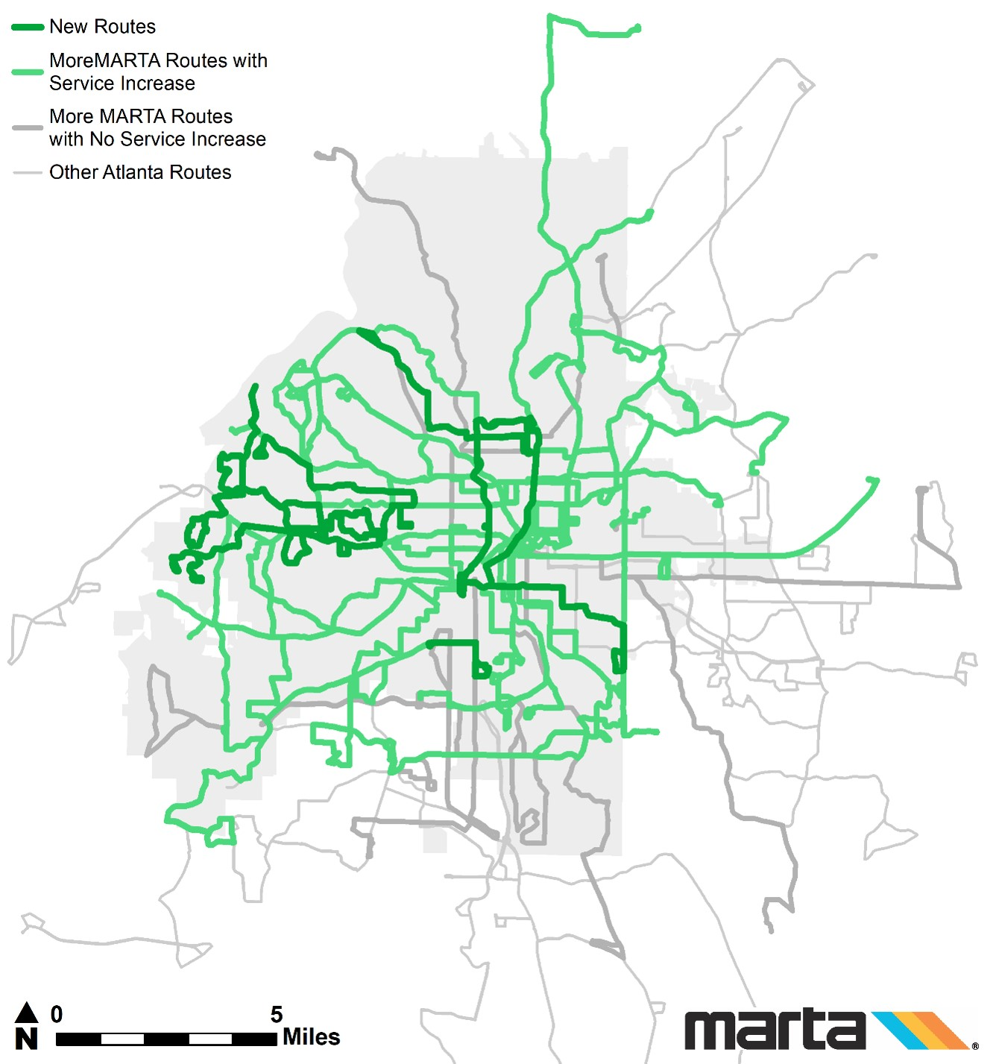

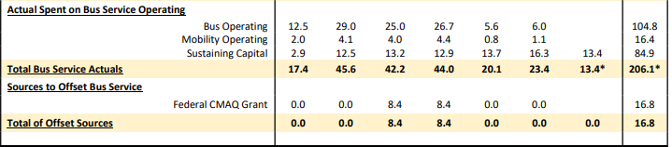
2019 ENHANCED BUS SERVICE
11 new routes
49 routes with increased frequency or service hours
Actual spend dropped due to COVID
* For FY2023 bus service and streetcar O&M actual costs will be included at the end of the fiscal year.

Slide 6
Summary of Annualized Revenue Hours on More MARTA Routes
MORE MARTA ATLANTA ENHANCED BUS SERVICE LEVELS
1,155,014
Even once fully restored to the August 2021 service level, More MARTA routes will see relatively low levels of extra service compared to December 2018.
At the August 2021 service level, 89.3% of More MARTA enhancement hours will remain unrestored compared to their peak in December 2018
This is only 2.3% more hours than the pre-More MARTA level in December 2016
1,065,493
918,833
944,072
940,360
Baseline of pre-More MARTA revenue hours
Pre-More MARTA revenue hours
More MARTA Bus Enhancements revenue hours
Dec ‘16
Dec ‘18
April ‘20
Aug ‘21
April ‘23

Slide 7
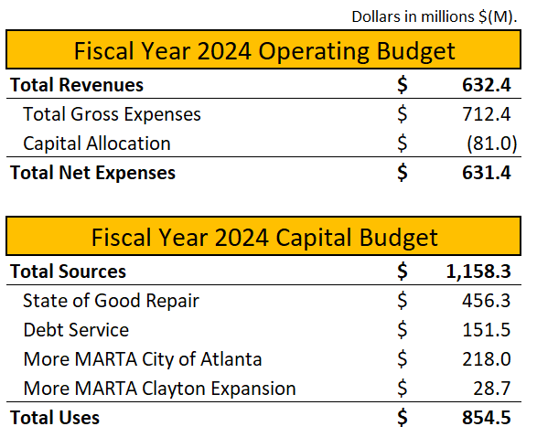
FY24 BUDGET OVERVIEW

Slide 8
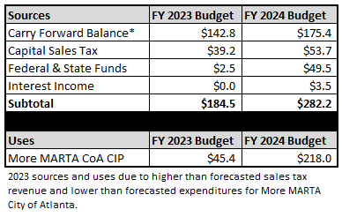
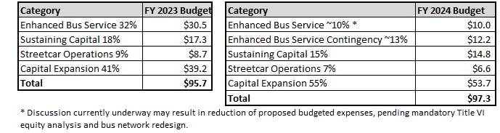
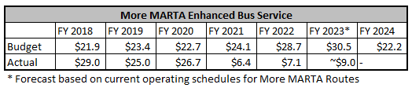
More MARTA Atlanta Sources and Uses (Dollars in Millions)
FY24 MORE MARTA ATLANTA BUDGET
More MARTA Atlanta Capital and Operations Sales Tax Breakdown

Slide 9
MORE MARTA ATLANTA FY24 CAPITAL BUDGET

Slide 10
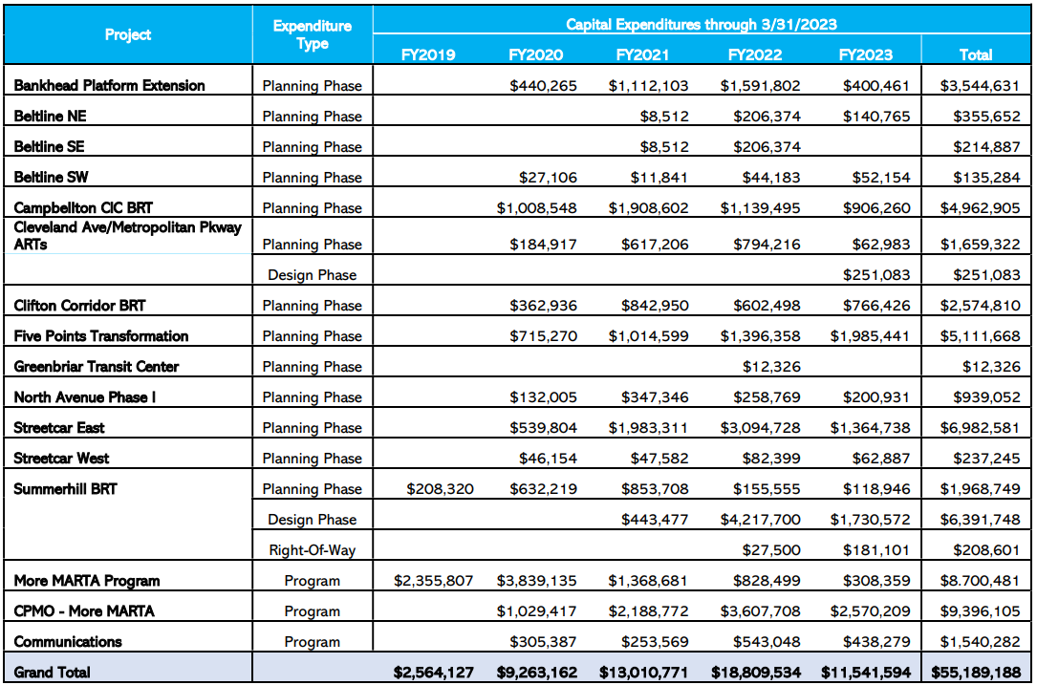
MORE MARTA ATLANTA CAPITAL EXPENDITURES

Slide 11
Agenda
Project Updates

Slide 12
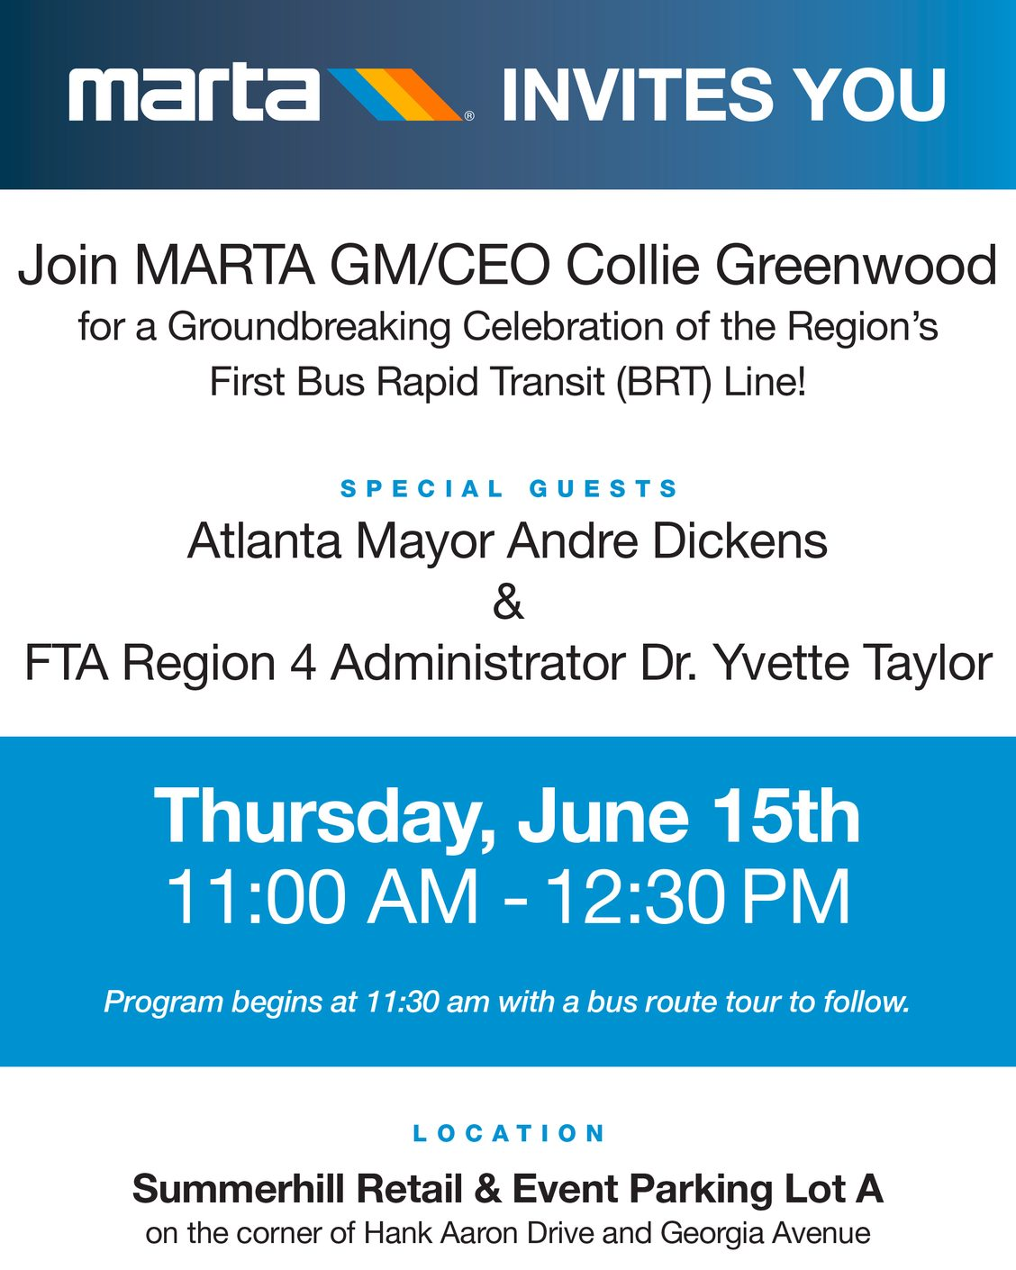
SUMMERHILL BUS RAPID TRANSIT
PHASE: CONSTRUCTION
Utility construction by Atlanta Watershed ongoing
Construction contract approved by MARTA Board – Archer Western
Vehicle procurement contract approved by MARTA Board
Groundbreaking on June 15th
ROW acquisition continues

Slide 13
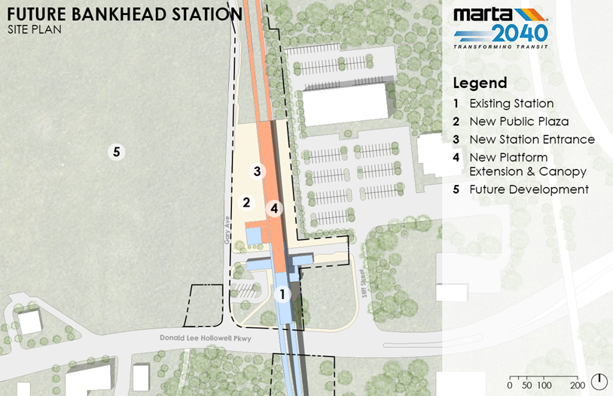
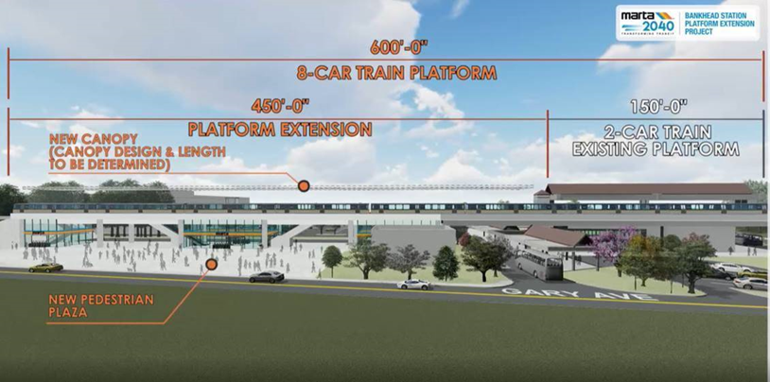
PROJECT PROGRESS: BANKHEAD STATION PLATFORM EXTENSION
PHASE: FINAL DESIGN
Final Design consultant selected through competitive procurement
MARTA Board approved award of contract to Axis Infrastructure on June 8th
Coordination with transit-oriented development (TOD) master plan study

Slide 14
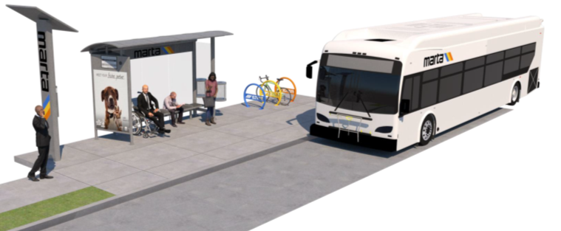
PROJECT PROGRESS:
CLEVELAND AVE ART and METROPOLITAN PKWY ART
PHASE: FINAL DESIGN
Cleveland Ave ART and Metropolitan Pkwy ART –100% design plans received on June 1st, under review by all parties
Continued right-of-way coordination, MARTA Board approved request for Round 1 offers on June 8th
Procurement of shelters is underway
Industry Day scheduled for June 28th
Ongoing coordination with City of Atlanta, City of East Point and Georgia Department of Transportation (GDOT)

Slide 15
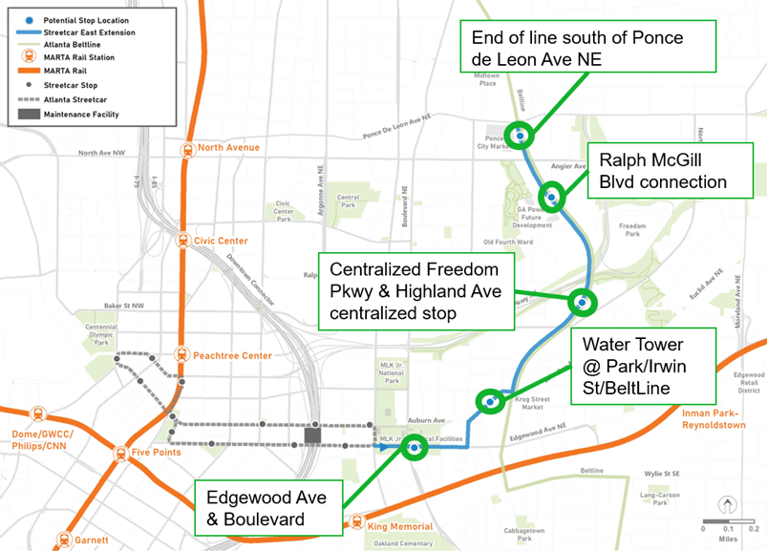
PROJECT PROGRESS – STREETCAR EAST EXTENSION
PHASE: TRANSITION TO FINAL DESIGN
MARTA Board approved LPA for the project on April 13
Active procurement for Final Design Consultant – proposals received on May 25
Selection committee evaluations underway

Slide 16
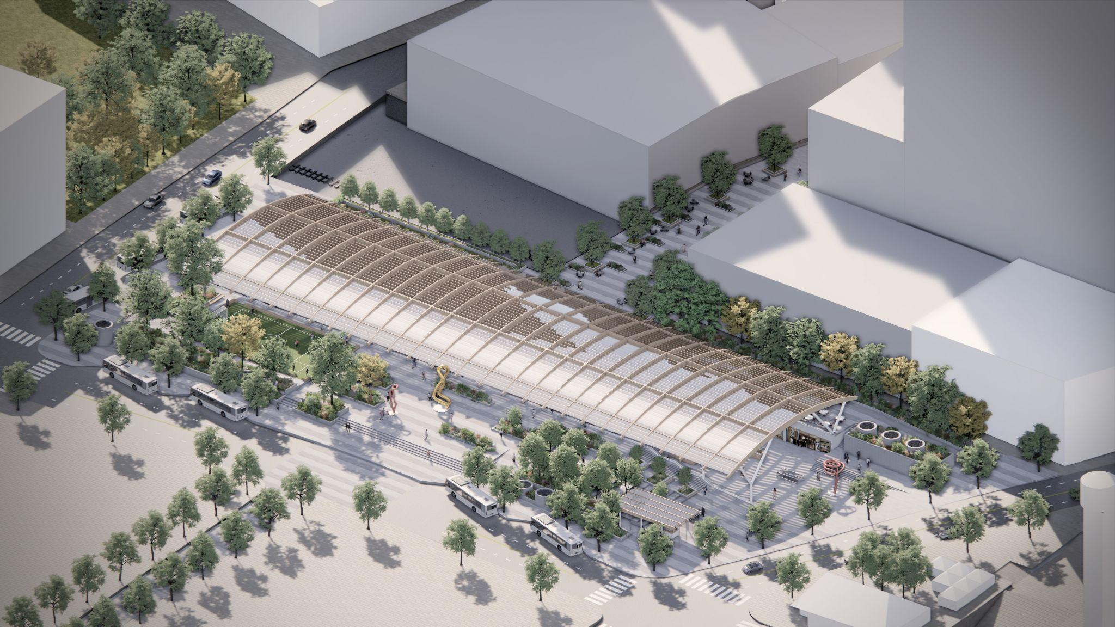
PROJECT PROGRESS: FIVE POINTS TRANSFORMATION
PHASE: TRANSITION TO FINAL DESIGN
Concept selected – Option 9A – presented to MARTA Board on March 9th
Continued advancement of the canopy deconstruction design
Working collaboratively with the Administration to explore design refinements for cost and time savings

Slide 17
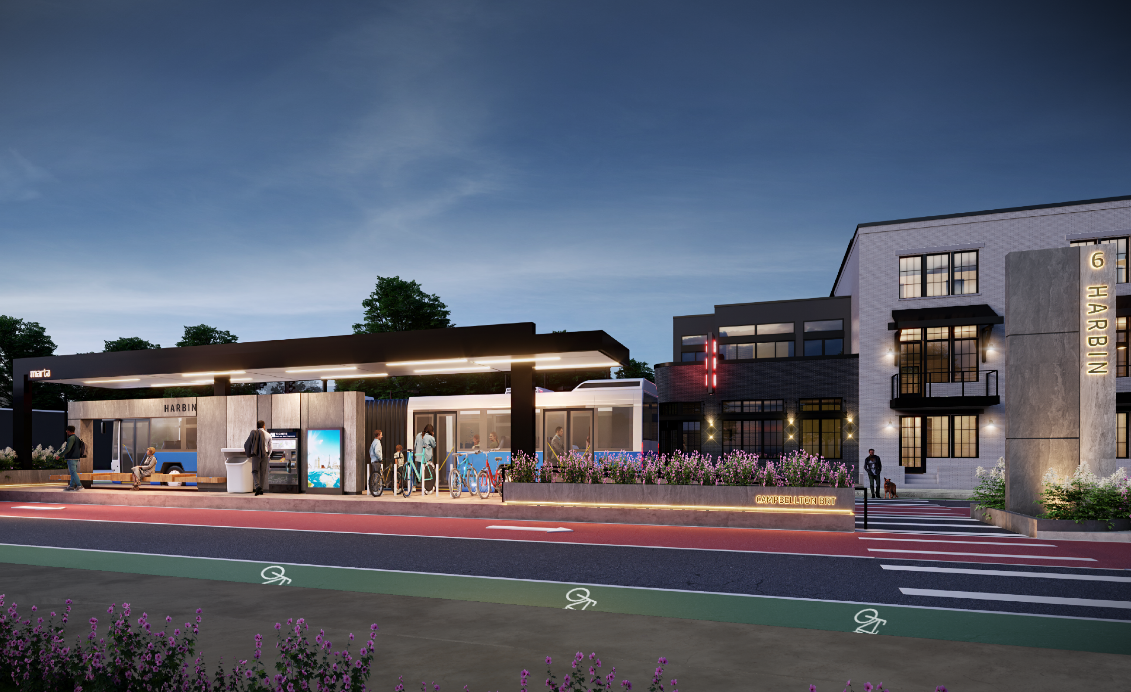
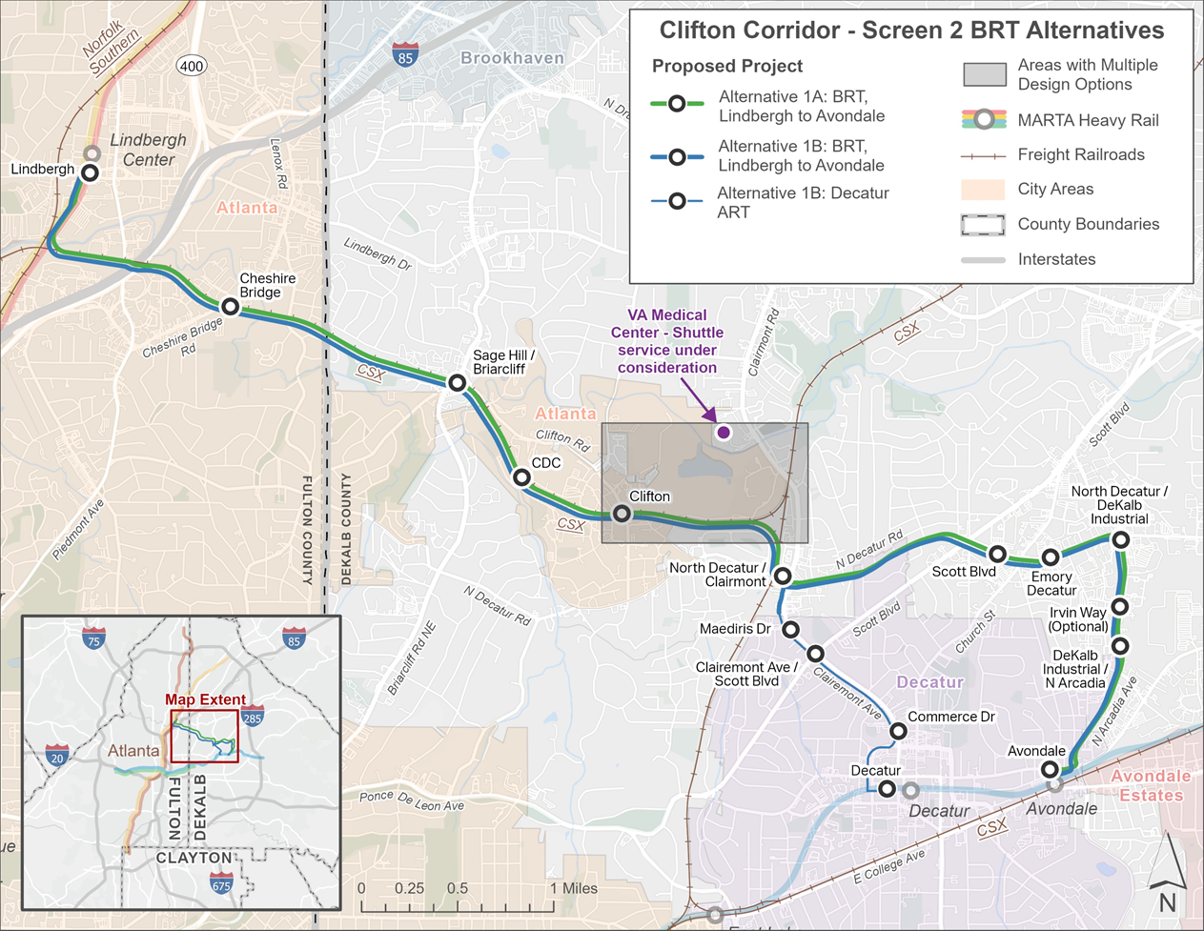
CORRIDOR PROJECTS
PHASE: PLANNING
Campbellton Community Investment Corridor BRT
  Advancement towards 30% design
  NEPA checklist submission
  Pre-award authority from FTA of $8.1M
Clifton Corridor BRT – Alternatives Analysis has narrowed down to two alternatives:
  BRT Lindbergh to Avondale
  BRT Lindbergh to Avondale + ART Decatur spur
  Ridership model refinement – applicable to all projects

Slide 18
Agenda
Additional Good News

Slide 19
RIDERSHIP UPDATE
4.4 Million
3.7 Million
2.7 Million
2.7 Million
65.3 Thousand
59.4 Thousand
19.5 Thousand
13.2 Thousand

Slide 20
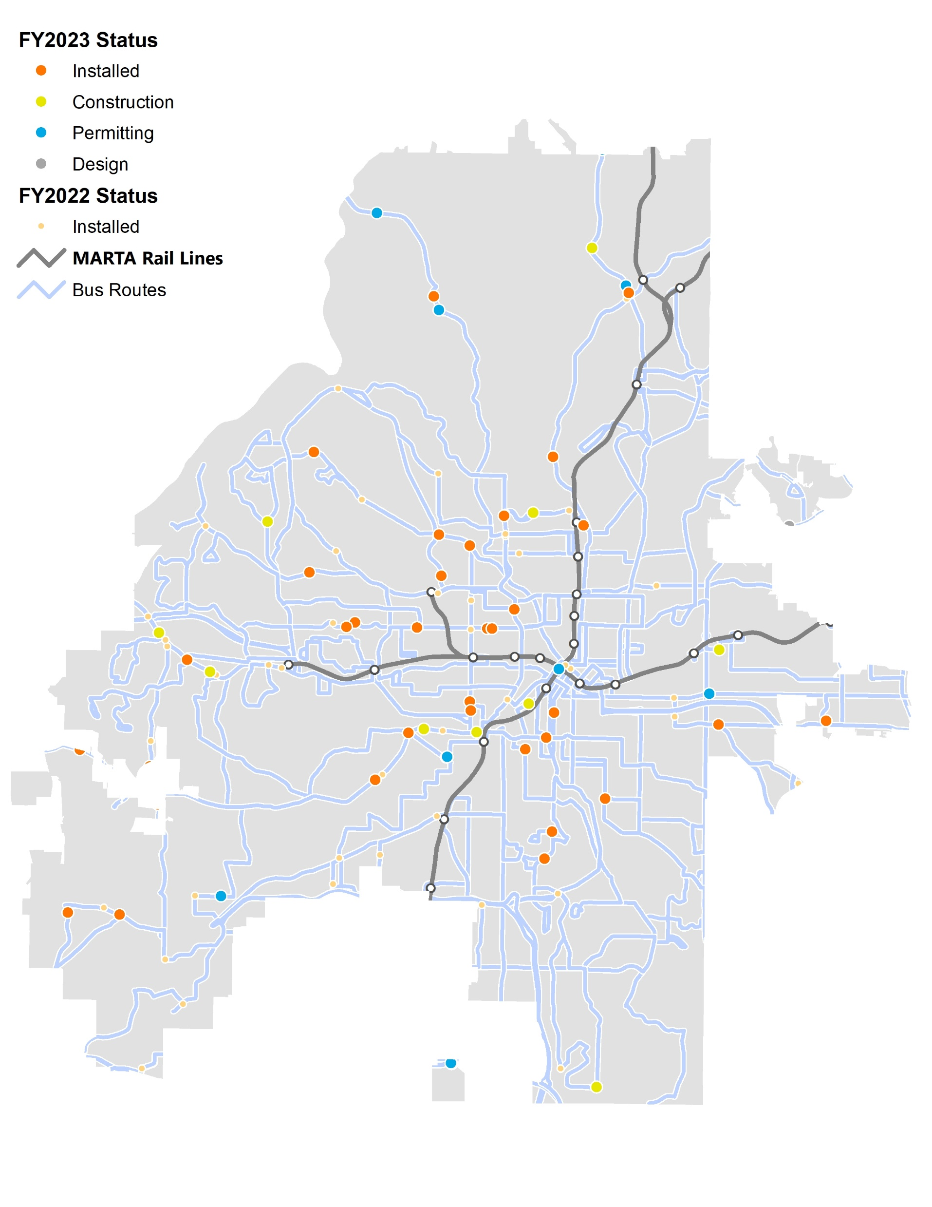
BUS SHELTERS & AMENITIES UPDATE
FY23 Amenities Status
  33 amenities installed
  10 under construction
  7 in permitting

Slide 21
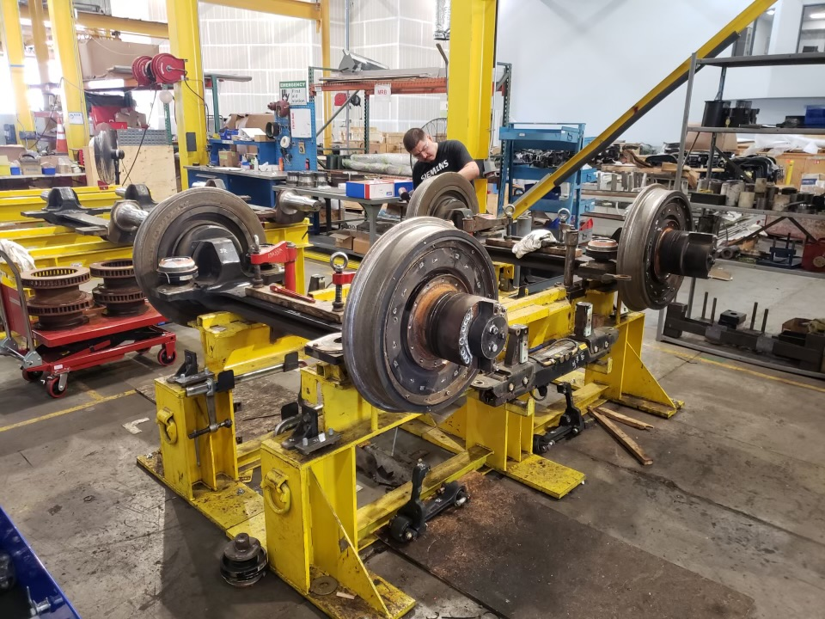
STREETCAR RETURN TO SERVICE UPDATE
First two Streetcars returned to service in March.
Final sets of Streetcar trucks expected mid-June, with all four cars in service by end of June.

Slide 22
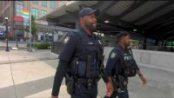
MARTA POLICE DEPARTMENT APTA GOLD AWARD
Partnership with Atlanta Police Department – Joint Bike Patrol Recognized

